Slide 1
Growth Factors
A focus on Neurotrophic factors in Neuroscience
Darius Foodeei, Samuel Garcin

Slide 2
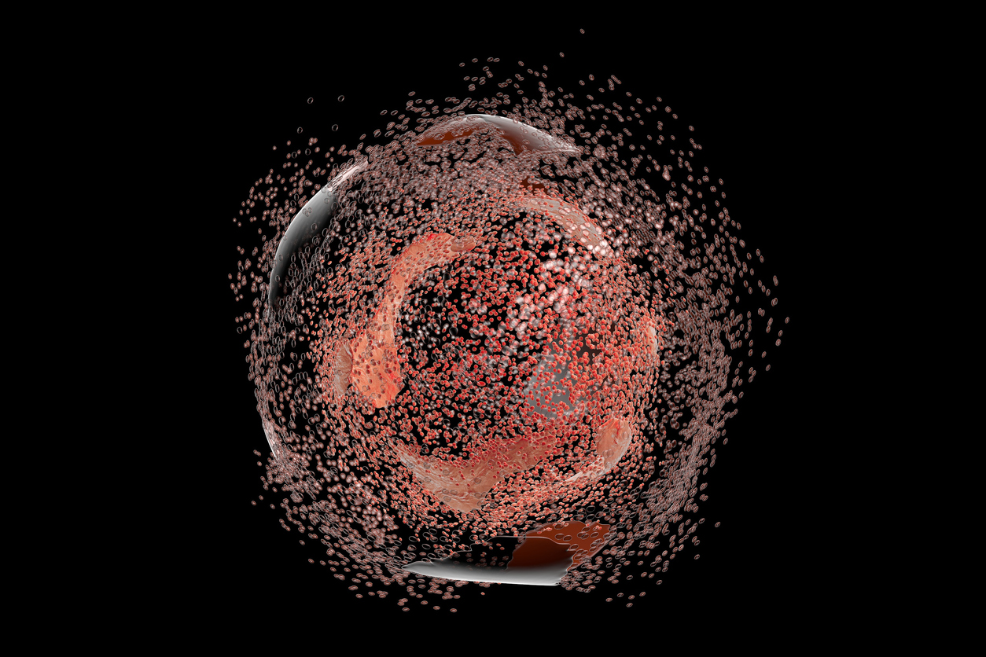
Introduction
Proteins that guide cell growth, survival, and development
Neurotrophic factors = “fertilizer” for neurons
Support synapse formation, plasticity, and repair
Main families:
  Neurotrophins (NGF, BDNF, NT-3, NT-4/5)
  GDNF family ligands (GDNF, Neurturin, etc.)
  EGF, IGF families (broader effects)
Acadeum Life Sciences

Slide 3
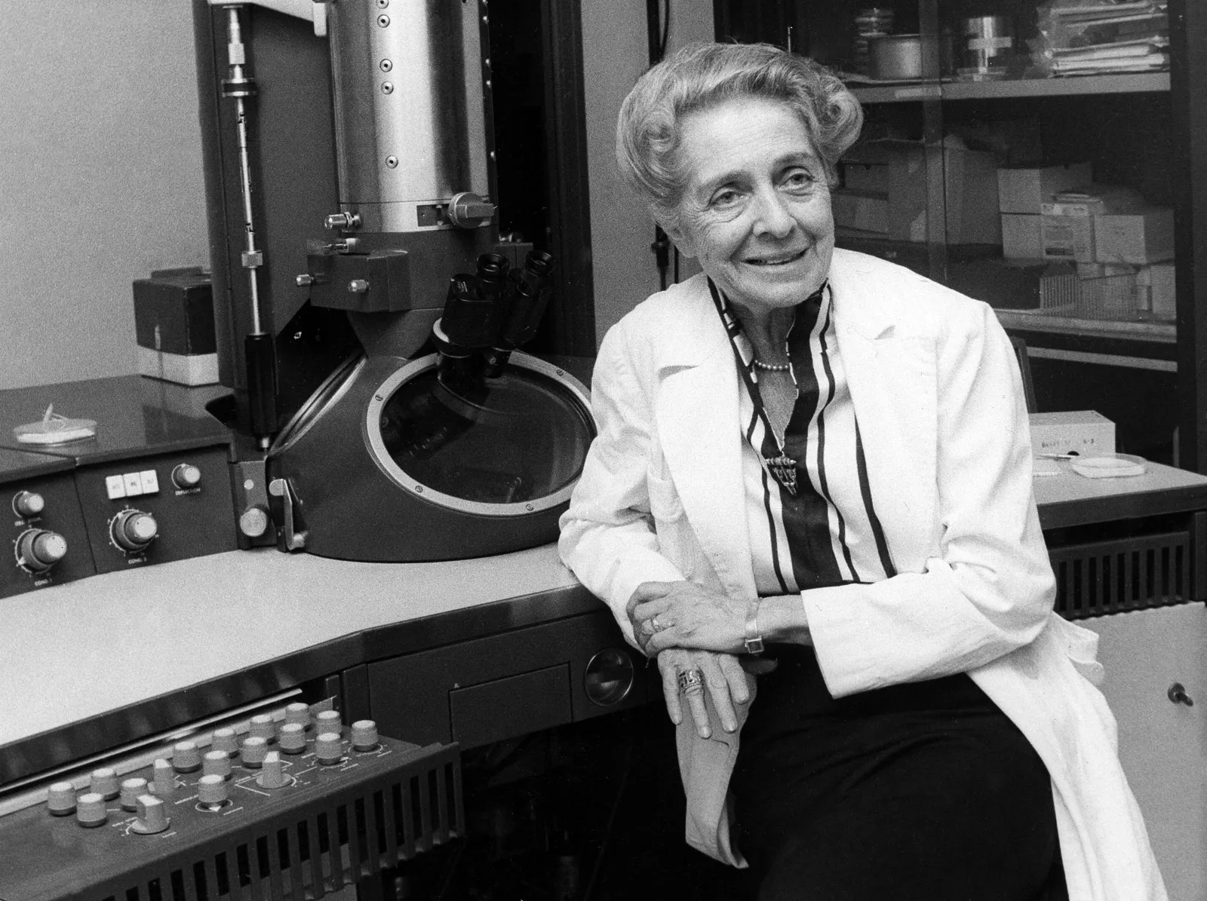
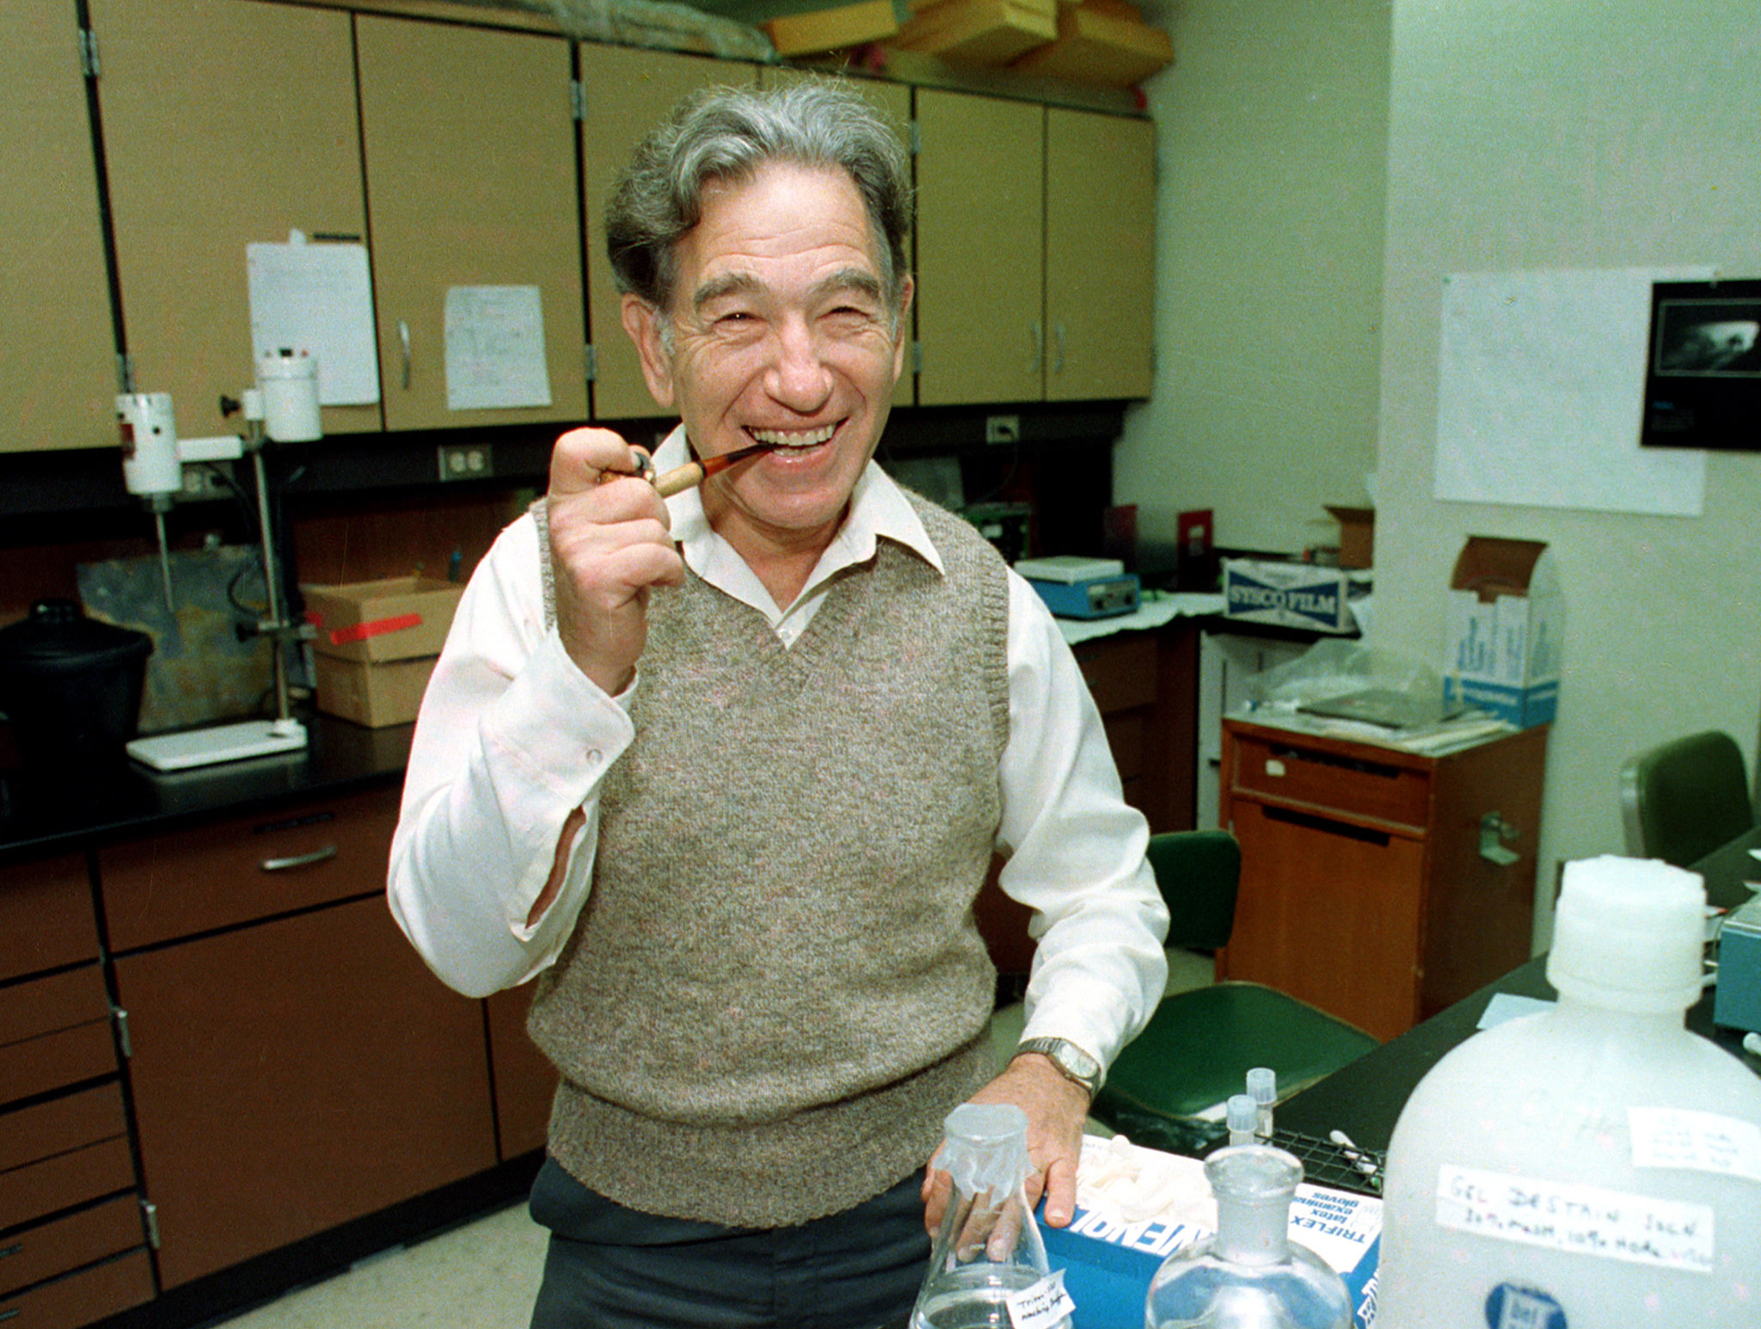
Historical Background
Pioneers of Growth Factor Research
1950s: Rita Levi-Montalcini discovers NGF using chick embryos → nerve fiber growth. Initially synthesized as a larger precursor.
1956: Stanley Cohen isolates EGF while studying NGF → explains tissue/organ development. EGF was originally discovered in submaxillary glands of mice and human urine, and was initially known as "urogastrone" in humans.
1986 Nobel Prize: Awarded to Levi-Montalcini/Cohen for revealing "growth factors as universal regulators."
“NGF is to the nervous system what blood is to the circulatory system.” – Levi-Montalcini.

Slide 4
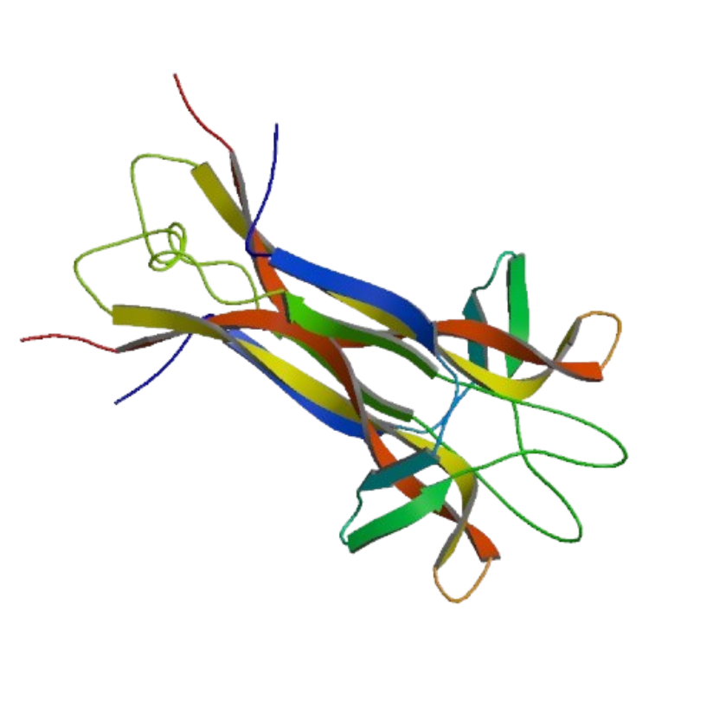
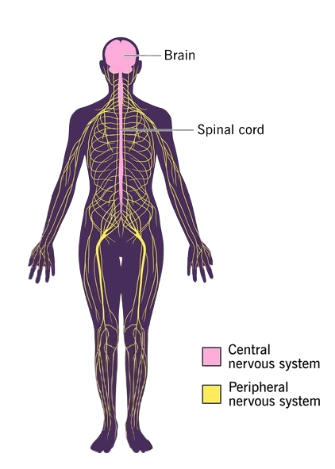
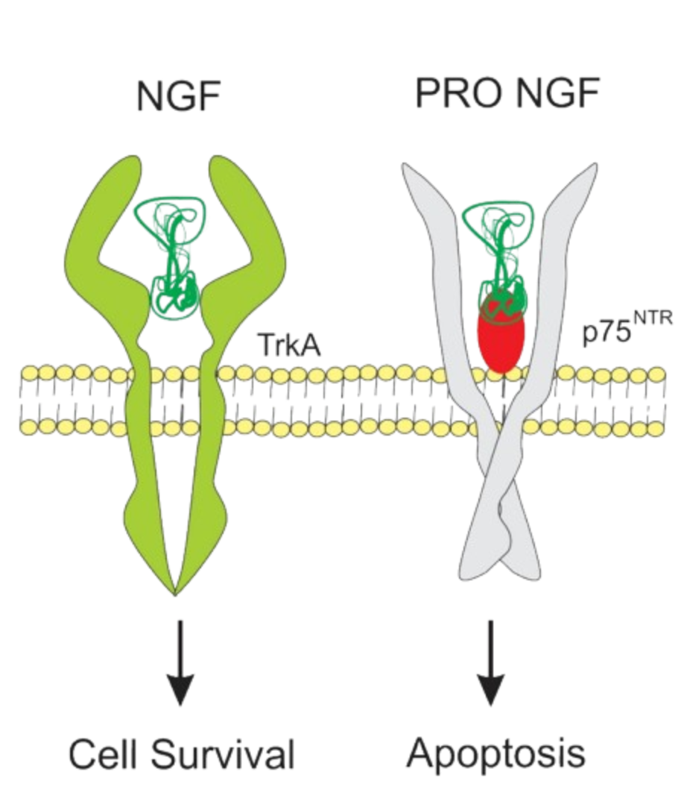
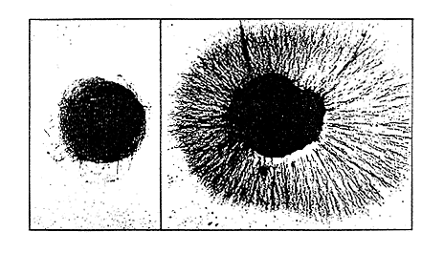
NGF Details
Essential for sensory, sympathetic, and basal forebrain neurons
Receptors:
  TrkA: survival, growth, connectivity
  p75NTR: modulates or triggers apoptosis
Binds receptors → “stay alive and grow connections”

Slide 5
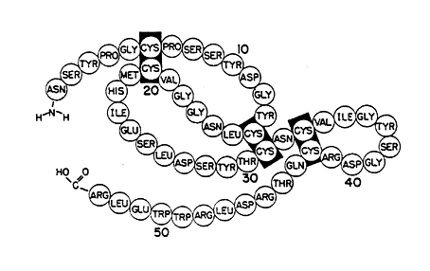
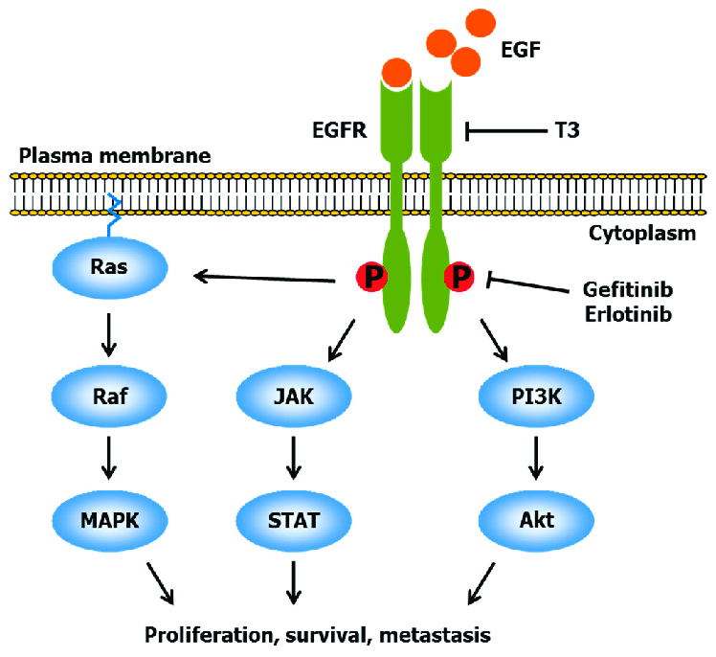
Epidermal Growth Factor (EGF)
Structure: 53 amino acids, 3 disulfide bonds (6 kDa).
Function:
Epithelial cell proliferation (skin, gut, cornea).
Accelerates wound healing via collagen/DNA synthesis.
Mechanism:
Binds EGFR → receptor dimerization → tyrosine kinase activation → cell division.
Did You Know? EGF is found in saliva, milk, and urine.
EGF is less directly involved in neuron differentiation (compared to NGF) but is important for maintaining the pool of neural stem cells.
Clinical implications : EGF in burn healing creams (e.g., Regranex), Gastrointestinal Repair, Cancer Therapy: EGFR inhibitors (e.g., cetuximab, panitumumab) target lung/colorectal cancers.

Slide 6
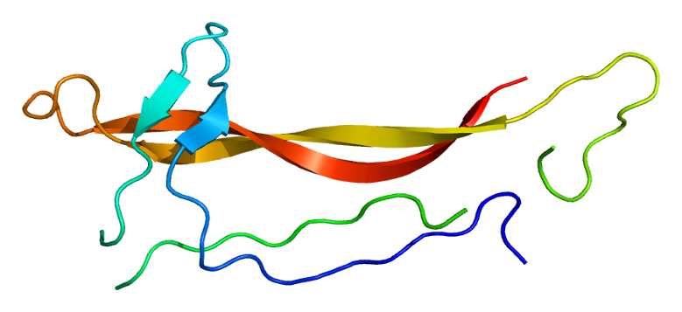
Neurotrophin 3 (NT-3)
Structure
Member of the neurotrophin family (with NGF, BDNF)
Homodimeric protein, “cystine knot” structure (three disulfide bonds)
Functions
Supports survival, growth, and differentiation of neurons in both the central and peripheral nervous systems
Essential for development and maintenance of proprioceptive and mechanoreceptive sensory neurons
Key regulator of enteric nervous system (ENS) development and gut motility
Promotes synapse formation and plasticity in CNS and PNS
Mechanism of Action
Binds primarily to high-affinity TrkC receptor (tyrosine kinase), can also signal through TrkB and low-affinity p75NTR
Clinical: Gene therapy (AAV1.NT-3) for Charcot-Marie-Tooth disease; reduces neuropathic pain

Slide 7
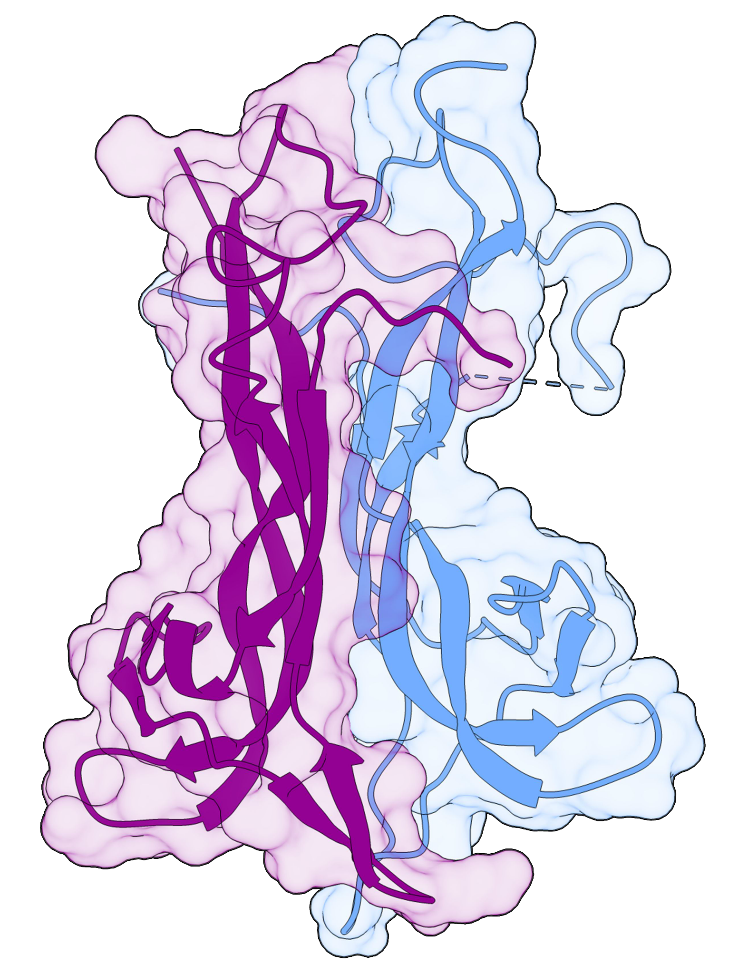
Brain-derived neurotrophic factor (BDNF)
Structure & Family
Member of the neurotrophin family (with NGF, NT-3)
Widely expressed in brain regions: hippocampus, cortex, basal forebrain
Functions
Supports survival, growth, and differentiation of neurons
Essential for synaptic plasticity, learning, and memory (especially LTP in hippocampus)
Modulates both excitatory and inhibitory synaptic transmission
Promotes adult neurogenesis and dendritic spine growth
Mechanism
Signals via TrkB (high-affinity) and p75NTR (low-affinity) receptors
Activates PI3K/Akt, MAPK, and PLC-γ pathways for neuronal survival and plasticity

Slide 8
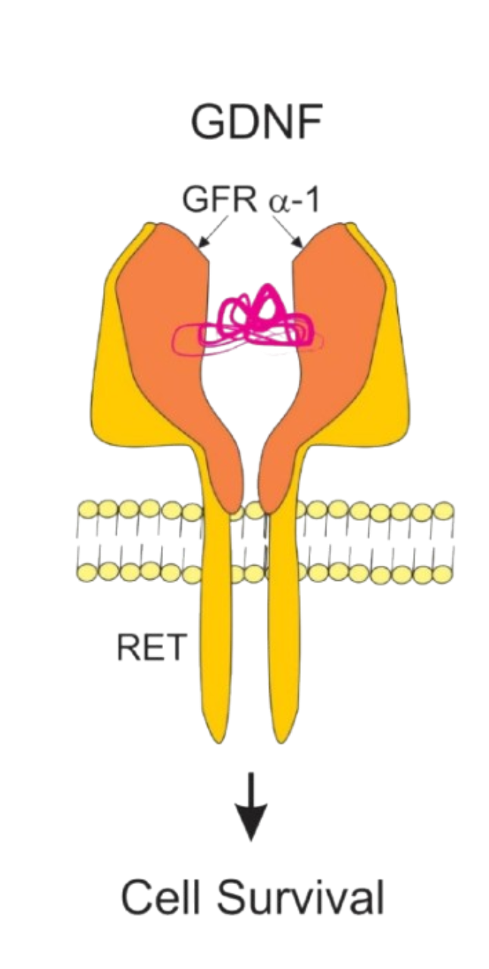
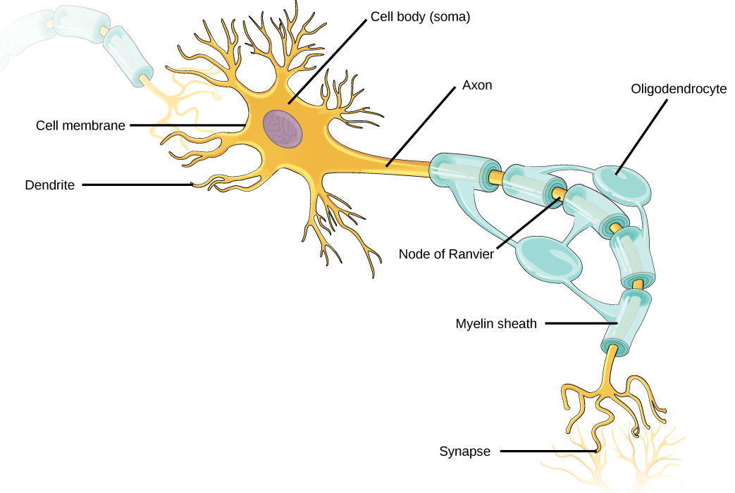
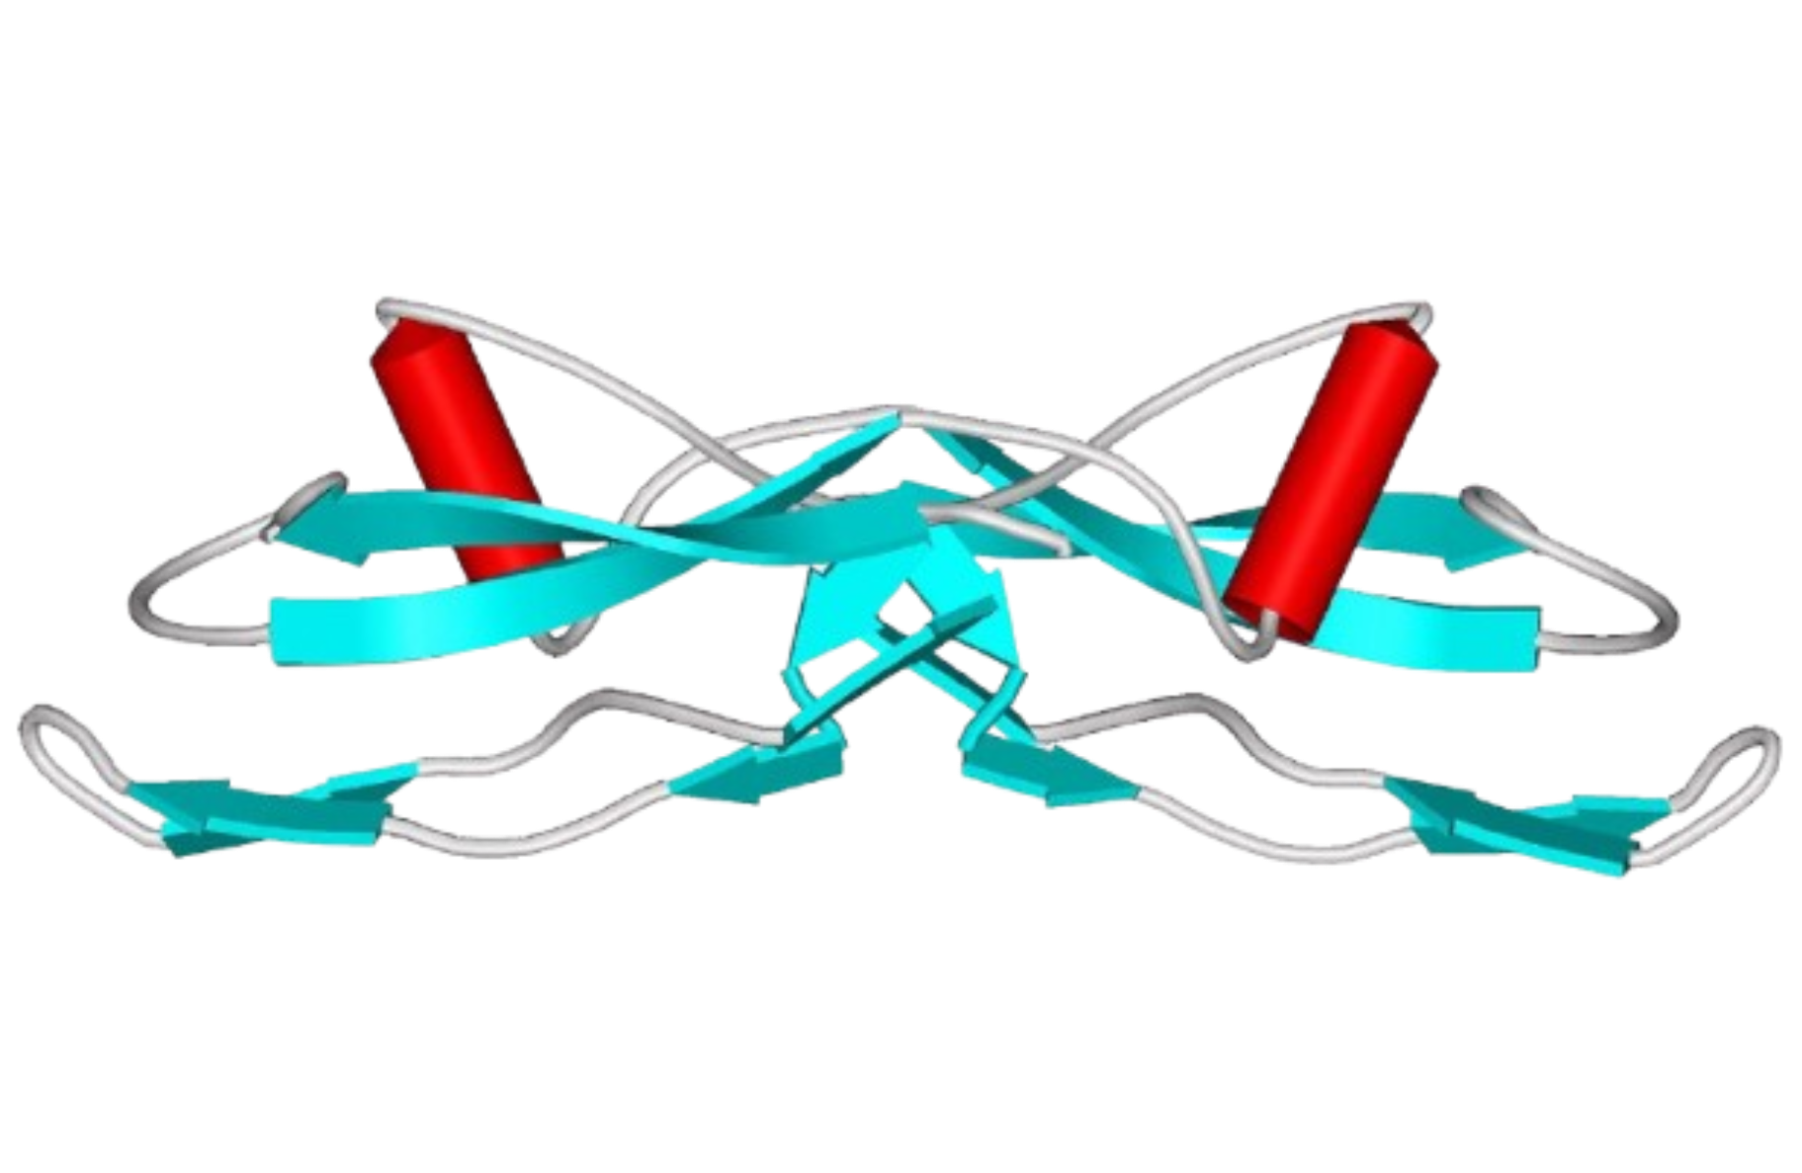
GDNF (Glial cell line-derived neurotrophic factor)

Slide 9
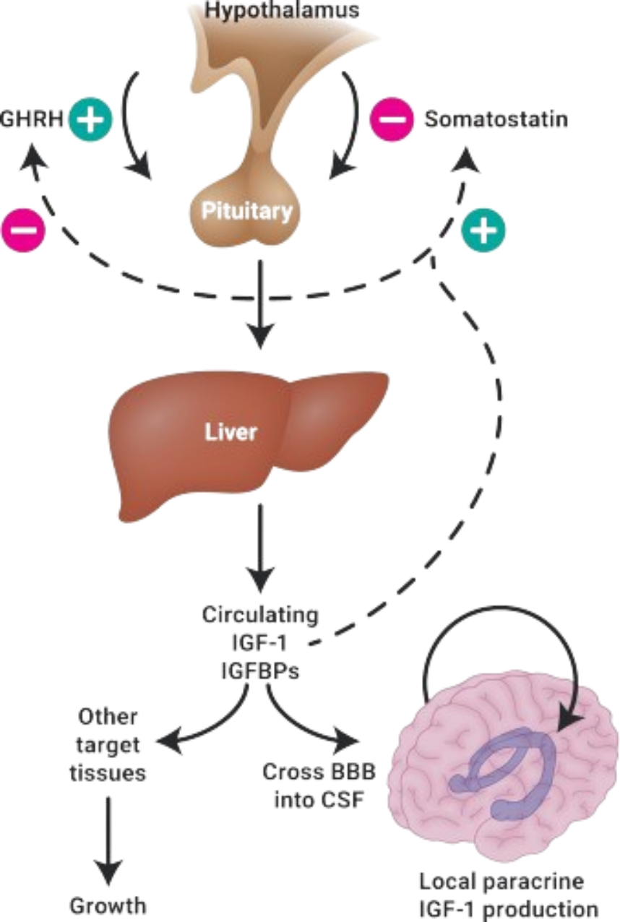

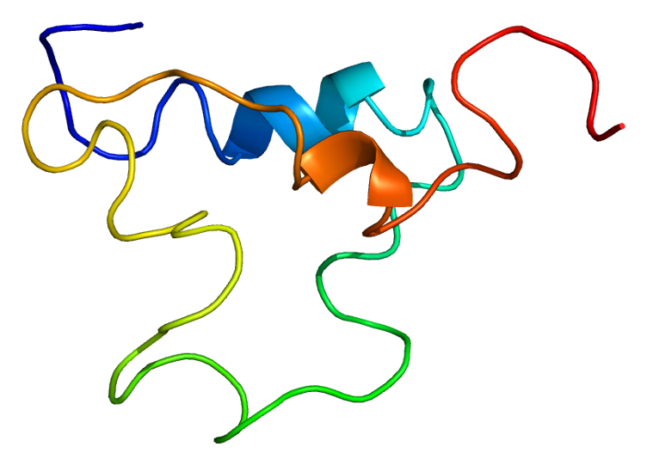
IGF-1

Slide 10
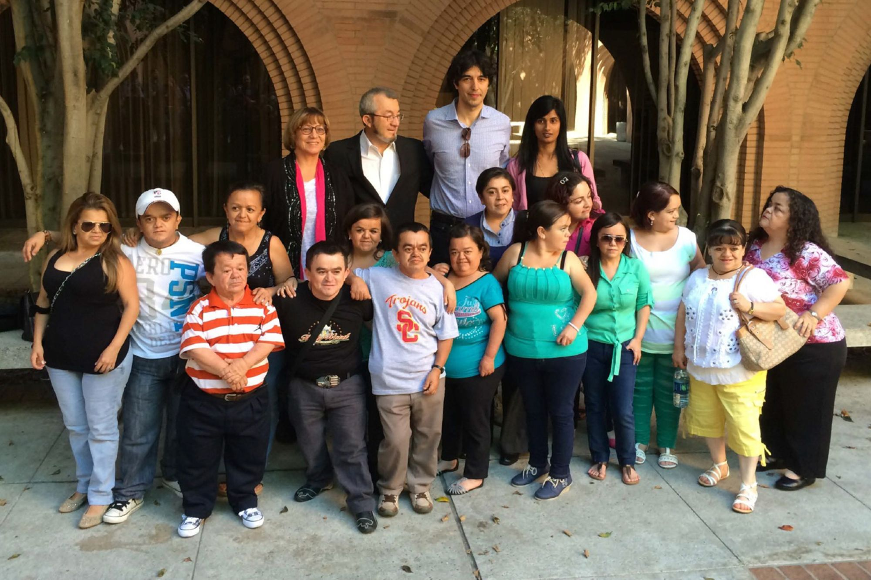
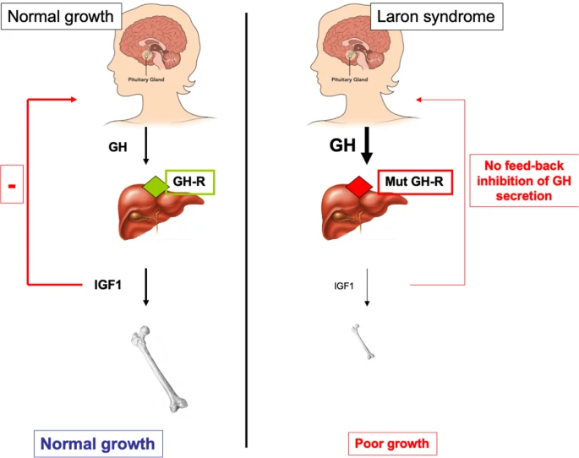
Laron syndrome

Slide 11
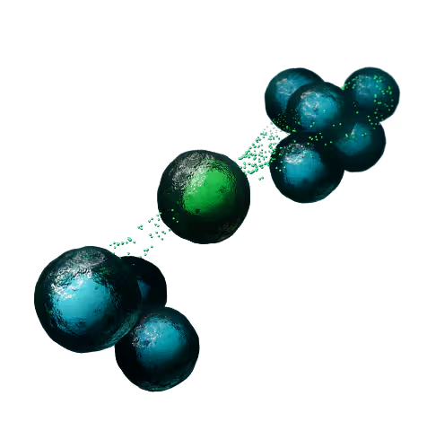
Conclusion : The future of growth factors
Impact: Revolutionized understanding of cell communication.
Next Steps:
  Targeted delivery (nanoparticles, viral vectors).
  Combinatorial therapies (e.g., NGF + GDNF for neurodegeneration).
“Growth factors are the language cells use to build life.”
https://www.bio-techne.com/reagents/proteins/growth-factors

Slide 12
Sources of images
NGF structure: https://cdn1.sinobiological.com/neurotrophic-factor-receptor/NGF-monomer.jpg
CNS & PNS: https://my.clevelandclinic.org/health/body/23123-peripheral-nervous-system-pns
Cell Expansion: https://www.nobelprize.org/prizes/medicine/1986/press-release/
Glial cell: https://opentextbc.ca/biology/chapter/16-1-neurons-and-glial-cells/
GDNF: https://www.aginganddisease.org/article/2015/2152-5250/147488/null/thumbnail/ad-6-5-331-g3.jpg
Laron syndrome: https://www.nature.com/articles/s41434-022-00329-2
Stanley Cohen : New York Times
BDNF : Wikipedia
Rita Levi-Montalcini : Britannica
Perplexity
Wikipedia

